Slide 1

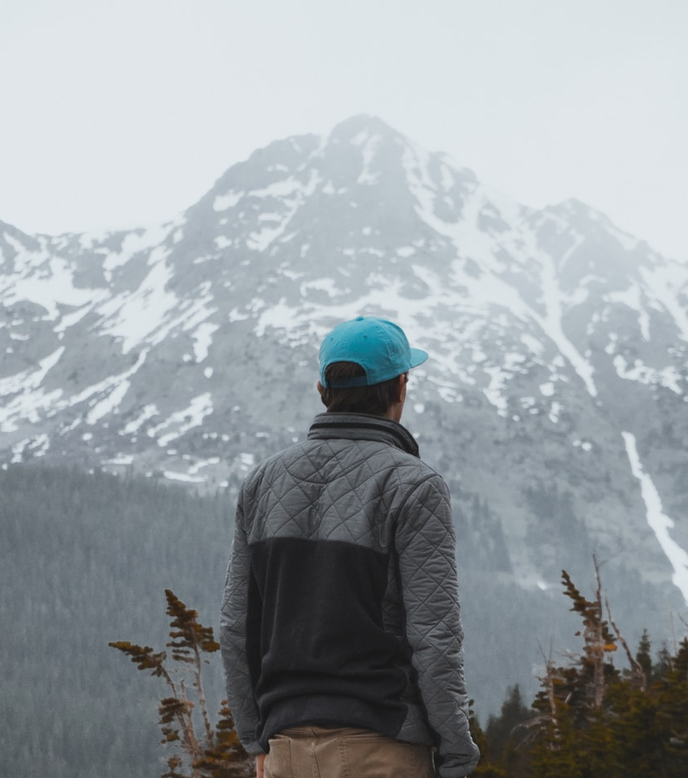

Live Class
Via Zoom
Chapter VIII.
Into the Wild

Slide 2



Index / Índice. “Into the Wild”
1
Introduction and Objective
6
Complete the Sentence
2
Seasons and Weather
7
Talking about the Past
3
Places and Part of Nature
8
Modes of Transport
4
Fact, Fiction and Opinion
9
My Last Trip
5
Past Tense Review
10
What have I learnt today?
Book II: Linda in Real Life
Centro de Idiomas 2019

Slide 3
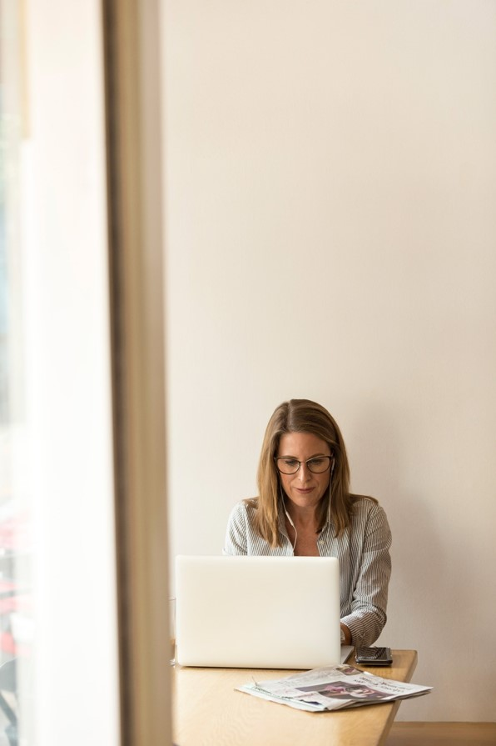
Part I. Introduction
Welcome to this live videoconference class!
In this final part of the chapter, you’ll put into practice everything you’ve learnt in the previous steps through dialogues, monologues, group discussion, games and other fun exercises.
The class is an important moment through which you can interact with your teacher and classmates in the contextualized situations from your virtual journey to learn English aboard.
Good luck!
¡Bienvenido / Bienvenida a esta clase por videoconferencia en vivo!
En esta parte final del capítulo, pondrás en práctica todo lo que has aprendido en los pasos previos a través de diálogos, monólogos, grupos de discusión, juegos y otros ejercicios divertidos.
La clase es un momento importante a través del cual puedes interactuar con tu maestro y compañeros en las situaciones contextualizadas de tu viaje virtual para aprender inglés en el extranjero.
¡Buena suerte!
Book II: Linda in Real Life
Centro de Idiomas 2019

Slide 4
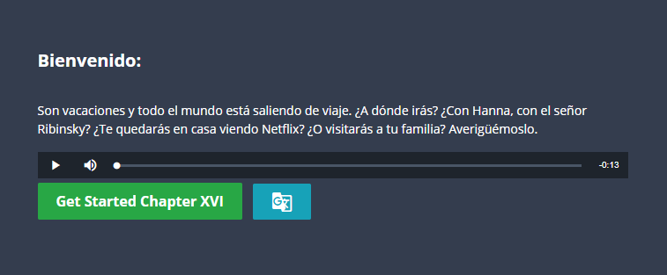
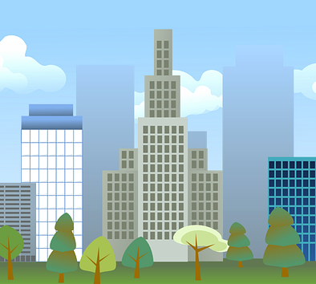
Part I. Class Objective
By the end of the class, you will be able to recognize vocabulary related to nature, distinguish between a fact and an opinion, talk about and order events in the past, as well as discuss the topic of travel.
Al final de la clase, serás capaz de reconocer el vocabulario relacionado con la naturaleza, distinguir entre un hecho y una opinión, hablar y ordenar eventos en el pasado, así como hablar del tema de viajar.
Book II: Linda in Real Life
Centro de Idiomas 2019

Slide 5
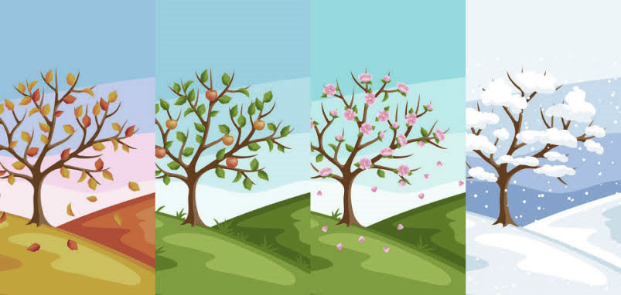
Instructions: Let’s review the four seasons of the year from the last chapter.
Part II. Seasons and Weather
Book II: Linda in Real Life
Centro de Idiomas 2019

Slide 6
Instructions: Now we’re going to describe the weather you find in these seasons.
Part II. Seasons and Weather
Book II: Linda in Real Life
Centro de Idiomas 2019

Slide 7
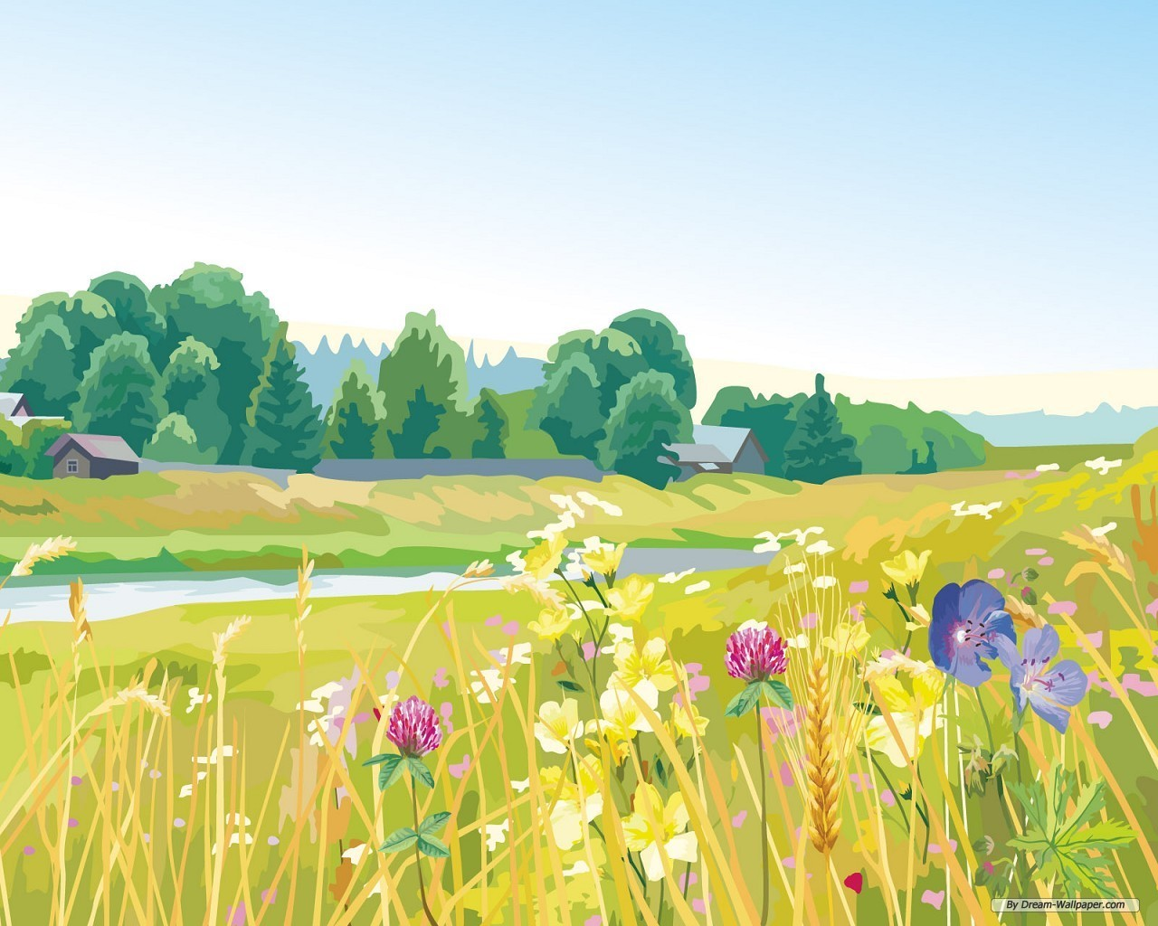
Instructions: Match the vocabulary related to nature with the definitions.
Part III. Places and Parts of Nature
1. Countryside – a place that is not in cities and has farms, fields and forests
2. Valley 3. Cliff 4. Fountain 5. Lake 6. Hill 7. Mountain 8. Forest 9. Tree
a tall plant that has branches coming from it and leaves
a large area of water that has land all around it
a very high hill
a structure that forces water up into the air
a raised area of land, smaller than a mountain
a large area of trees growing closely together
an area of low land between hills or mountains
an area of high, steep rocks beside the sea
Book II: Linda in Real Life
Centro de Idiomas 2019

Slide 8
Instructions: Match the vocabulary related to nature with the definitions.
Part III. Places and Parts of Nature
10. Plants
11. Desert
12. Stream
13. Footpath
14. Flower
15. Field
16. Rock
17. Cave
18. Lagoon
an area of land used for crops or keeping animals
a path for people to walk along in the countryside
a lake that contains sea water
the hard, natural substance of the Earth's surface
a large, hot, dry area of land with very few plants
a large hole in a cliff, mountain, or under the ground
a small river
an attractive, coloured part of a plant with seeds
a living thing that grows and has leaves and roots
Book II: Linda in Real Life
Centro de Idiomas 2019

Slide 9
Instructions: Match the vocabulary related to nature with the definitions.
Part III. Places and Parts of Nature
1. Countryside - land that is not in cities and has farms, fields, forests, etc
2. Valley: an area of low land between hills or mountains
3. Cliff: an area of high, steep rocks beside the sea
4. Fountain: a structure that forces water up into the air as a decoration
5. Lake: a large area of water that has land all around it
6. Hill: a raised area of land, smaller than a mountain
7. Mountain: a very high hill
8. Forest: a large area of trees growing closely together
9. Tree: a tall plant that has branches coming from it and leaves
Book II: Linda in Real Life
Centro de Idiomas 2019

Slide 10
Instructions: Match the vocabulary related to nature with the definitions.
Part III. Places and Parts of Nature
10. Plants: a living thing that grows and has leaves and roots
11. Desert: a large, hot, dry area of land with very few plants
12. Stream: a small river
13. Footpath: a path for people to walk along, especially in the countryside
14. Flower: the attractive, coloured part of a plant where the seeds grow
15. Field: an area of land used for growing crops or keeping animals
16. Rock: the hard, natural substance that forms part of the Earth's surface
17. Cave: a large hole in the side of a cliff, mountain, or under the ground
18. Lagoon: a lake that contains sea water
Book II: Linda in Real Life
Centro de Idiomas 2019

Slide 11
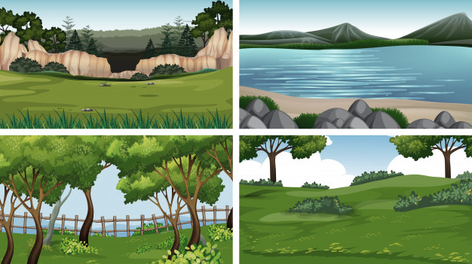
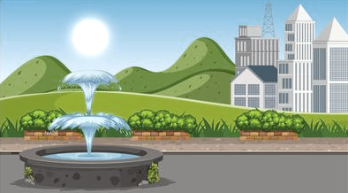
Instructions: Now it’s time to identify places and parts of nature. Remember to use ‘there is / there are’ to form complete sentences.
Part III. Places and Parts of Nature
Book II: Linda in Real Life
Centro de Idiomas 2019

Slide 12
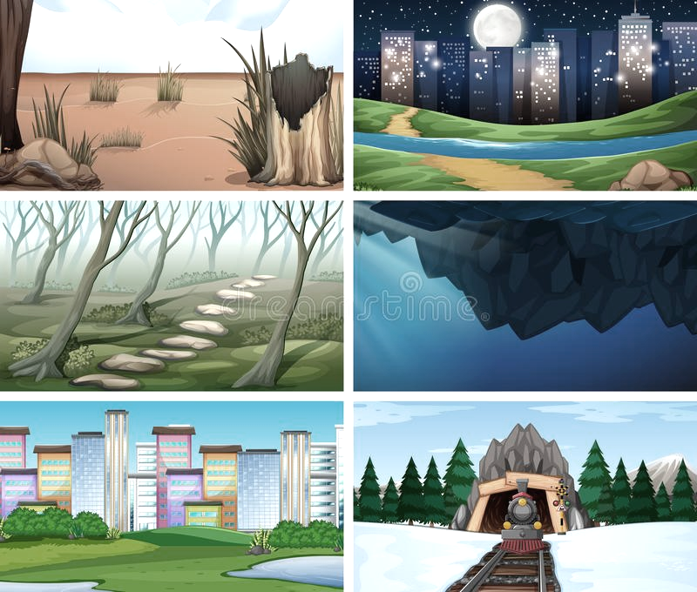
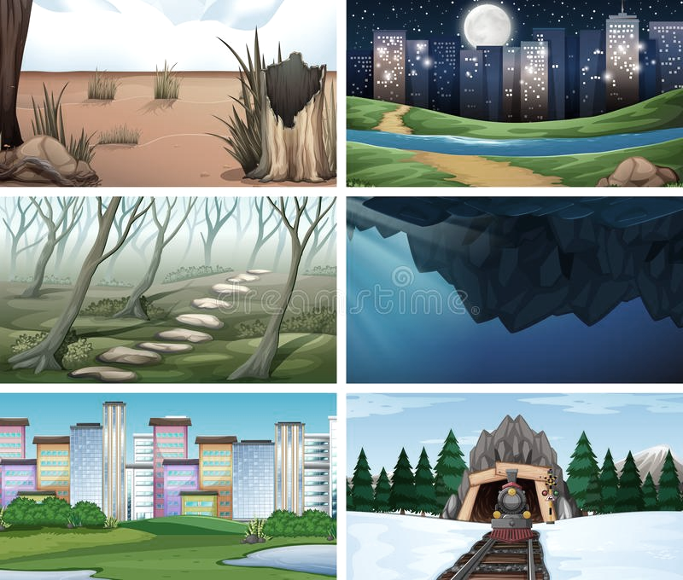
Part III. Places and Parts of Nature
Instructions: Now it’s time to identify places and parts of nature. Remember to use ‘there is / there are’ to form complete sentences.
Book II: Linda in Real Life
Centro de Idiomas 2019

Slide 13
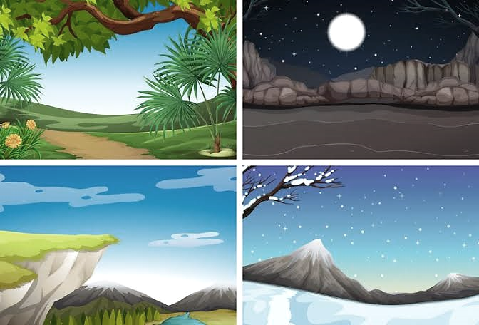


Instructions: Now it’s time to identify places and parts of nature. Remember to use ‘there is / there are’ to form complete sentences.
Part III. Places and Parts of Nature
Book II: Linda in Real Life
Centro de Idiomas 2019

Slide 14
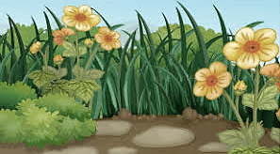
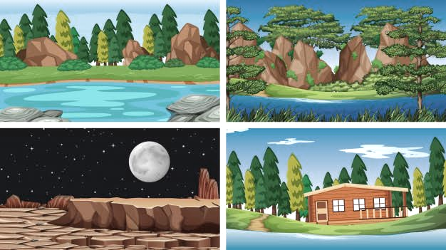
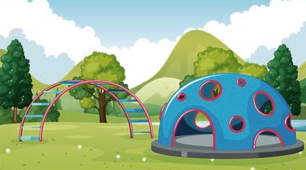
Instructions: Now it’s time to identify places and parts of nature. Remember to use ‘there is / there are’ to form complete sentences.
Part III. Places and Parts of Nature
Book II: Linda in Real Life
Centro de Idiomas 2019

Slide 15
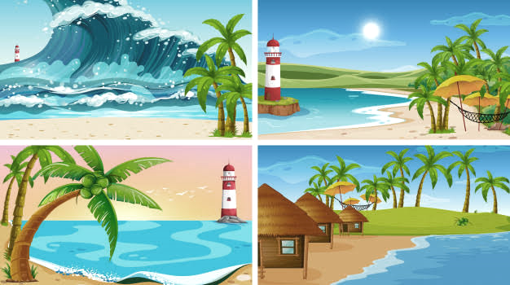
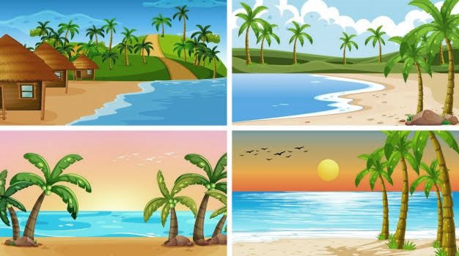
Instructions: Now it’s time to identify places and parts of nature. Remember to use ‘there is / there are’ to form complete sentences.
Part III. Places and Parts of Nature
Book II: Linda in Real Life
Centro de Idiomas 2019

Slide 16
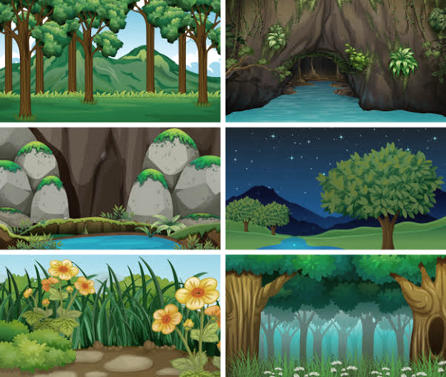
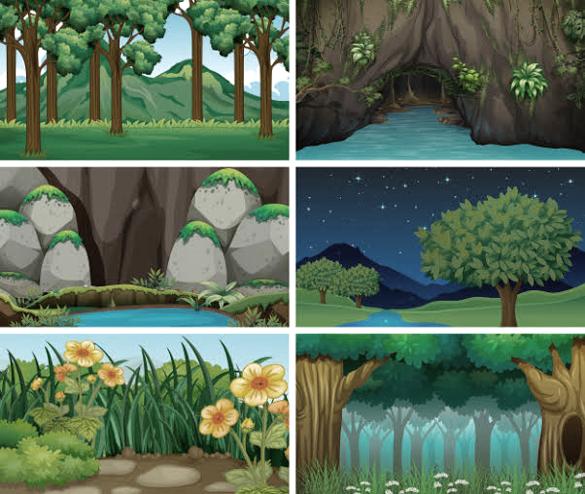
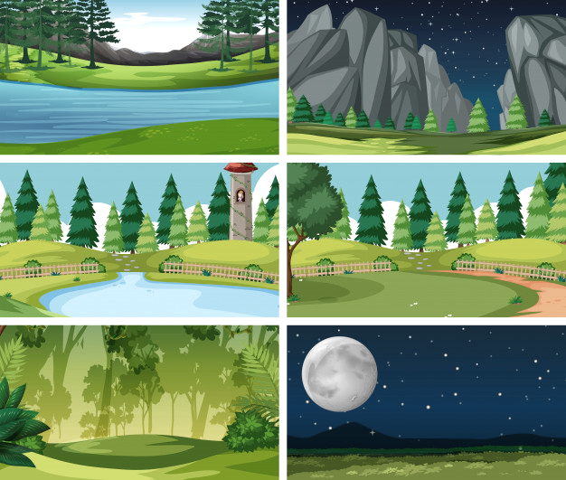

Instructions: Now it’s time to identify places and parts of nature. Remember to use ‘there is / there are’ to form complete sentences.
Part III. Places and Parts of Nature
Book II: Linda in Real Life
Centro de Idiomas 2019

Slide 17
Instructions: Read the sentences below and write fact or opinion on the line. A fact is a thing that is known or proved to be true. An opinion is a belief, judgment, or way of thinking about something. 1. Cows and horses sleep while standing up. ………………….. 2. A group of dog or wolves is called ‘a pack’. ………………….. 3. Every family should have a pet. ………………….. 4. Gold never erodes. ………………….. 5. The largest ocean on Earth is the Pacific Ocean. ………………….. 6. The Great Barrier Reef is the world’s largest coral reef system. ………………….. 7. Sunsets are beautiful. ………………….. 8. The largest land based mammals on Earth are elephants. ………………….. 9. It is great fun to swim in the sea. ………………….. 10. Roses have a lovely smell. ………………….. 11. It feels nice to walk on soft grass. ………………….. 12. The Killer Whale (Orca) is a type of dolphin. …………………..
Part IV. Fact, Fiction and Opinion
Book II: Linda in Real Life
Centro de Idiomas 2019

Slide 18
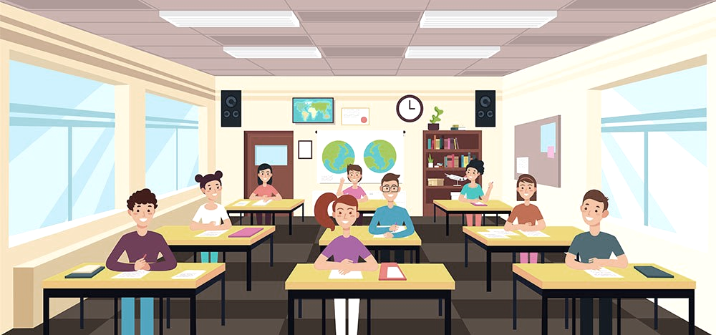
Instructions: Think of a fact that is true for you, one that is false and an opinion. The class will guess which is the true fact, which is the false one, and the opinion.
Part IV. Fact, Fiction and Opinion
Book II: Linda in Real Life
Centro de Idiomas 2019

Slide 19
Part V. Past Tense Review
We use the past tense to talk about:
1. something that happened once in the past:
I met my wife in 1983. We went to Spain for our holidays.
2. something that happened several times in the past:
When I was a boy, I walked a mile to school every day. We swam a lot while we were on holiday.
3. something that was true for some time in the past:
I lived abroad for ten years. He enjoyed being a student.
We often use expressions with ago with the past simple:
I met my wife a long time ago.
Book II: Linda in Real Life
Centro de Idiomas 2019

Slide 20
Part V. Past Tense Review
We use did to make questions with the past simple:
Did she play tennis when she was younger?
Did you live abroad?
When did you meet your wife?
But questions with who often don't use did:
Who discovered penicillin?
Who wrote Don Quixote?
We use didn't (did not) to make negatives with the past simple:
They didn't go to Spain this year.
I didn't see you yesterday.
Book II: Linda in Real Life
Centro de Idiomas 2019

Slide 21
Part VI. Complete the Sentence
Complete the following text using the past tense of the verbs in brackets.
Anna's holiday was (be) great last summer. She was staying (stay)
in a college in England for two weeks. She had (have) classes in the mornings and in the afternoons she did (do) some sports like swimming or tennis.
In the evenings she often went (go) dancing or watching (watch) films with her new friends.
At weekends they drove (drive) to some interesting places. Once they visited (visit) Marwell Zoo where they saw (see) some beautiful animals. Anna doesn’t like (not like) the food at the college but that wasn’t (not be) a problem. She met (meet) a lot of people and learned (learn) some English. All the students in her class was (be) sorry to go home. They all promised (promise) to come back next summer.
Book II: Linda in Real Life
Centro de Idiomas 2019

Slide 22
Part VI. Correct the Sentence
Correct the mistakes in the sentences then read them out loud.
She didn’t saw my grandma.
The police catched them.
Many people dieed in the earthquake.
Did she walked alone?
Celia and I was best friends.
He losted his job.
I goed to Zagreb yesterday.
My father tryed to repair his car yesterday afternoon.
Sarah weren’t happy last year.
She didn’t sold her house.
Book II: Linda in Real Life
Centro de Idiomas 2019

Slide 23
Part VII. Talking about the Past
With your classmates, ask and answer the questions in the past tense.
1. What did you do in the previous job?
2. What did you do for you last birthday?
3. Who was your first crush?
4. What was the last really difficult thing you had to do?
5. Who did you meet last week?
6. Tell me about what you did for the last 24 hours.
7. When was the last time you were really excited about something?
8. Tell me about where you lived as a child.
9. What was the best meal you ate recently?
10. When was the last time you went to a movie theater? What did you see?
11. Talk about the last time you were really scared.
12. Tell me about your best or worst school teacher.
Book II: Linda in Real Life
Centro de Idiomas 2019

Slide 24
Part VII. Talking about the Past
With your classmates, ask and answer the questions in the past tense.
13. What tech problems annoyed you recently?
14. What was your first TV like?
15. What are some events in the past that made you who you are?
16. What bands were popular when you were young?
17. When was the last time you were shocked?
18. What chores did you have to do when you were young?
19. Where did you hang out with your friends last? What did you do?
20. Who were some of your favorite sports stars in the past?
21. What did they play?
22. Why were they your favorite?
23. Why were they famous?
24. What was your best memory from when you were a child?
Book II: Linda in Real Life
Centro de Idiomas 2019

Slide 25
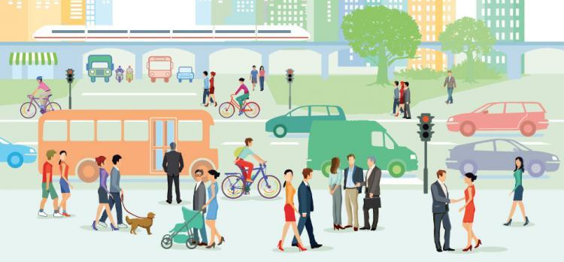
Part VIII. Modes of Transport
On the topic of travel, name modes of transport and when you use them.
Example: You take a plane when you travel long distances .
Book II: Linda in Real Life
Centro de Idiomas 2019

Slide 26
Part VIII. Modes of Transport
Now say the mode of transport and the last time you used it in the past.
Example: I took a train last month. I rode my bike yesterday.
Book II: Linda in Real Life
Centro de Idiomas 2019

Slide 27
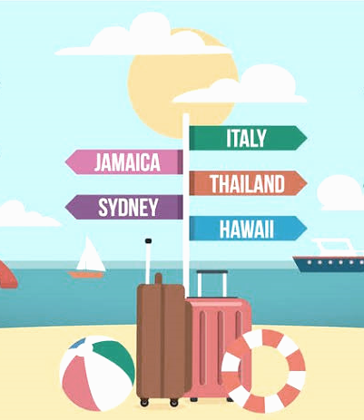
Part IX. My Last Trip
Describe your last trip into nature.
Use the past tense, modes of transport and places in nature that you saw.
You can use the questions below:
Where did you go?
When did you travel?
Who went with you?
How did you arrive?
What did you do there?
What was the best thing
that you saw there? Why?
Book II: Linda in Real Life
Centro de Idiomas 2019

Slide 28
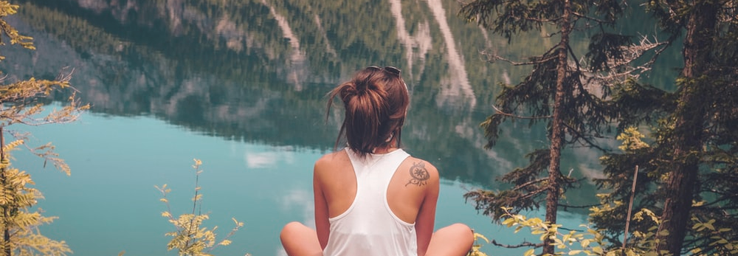
Part X. What have I learnt today?
What have I learnt today?
You can now recognize vocabulary related to nature, distinguish between a fact and an opinion, talk about and order events in the past, as well as discuss the topic of travel.
Book II: Linda in Real Life
Centro de Idiomas 2019

